Slide 1

StrongArm Tech
Take-Home

Slide 2

Project Background
An experiment at client’s warehouse in Albany
Job function: Package Handlers
Number of participants: 267 workers
Experimental Haptic Feedback settings: 3
Tracking:
Forward bend behavior
Tilt (side-to-side bend) speeds
Torso twist speeds
Composite Safety Score
Lift rate (productivity)

Slide 3
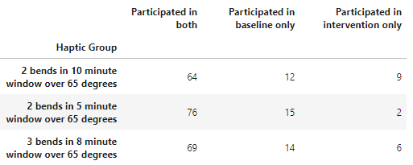
Experiment design
Assignment to 1 of 3 Haptic Groups
Intervention upon reaching :
2 high-risk bends in 5-minute window
3 high-risk bends in 8-minute window
2 high-risk bends in 10-minute window
(high-risk = above 65 degrees)
Experiment design assumptions
Randomized assignment to individuals
Randomized baseline vs. intervention assignment (or otherwise controlled for changes in conditions)
Participants that did not participate in both changes can be treated as “missing at random”

Slide 4
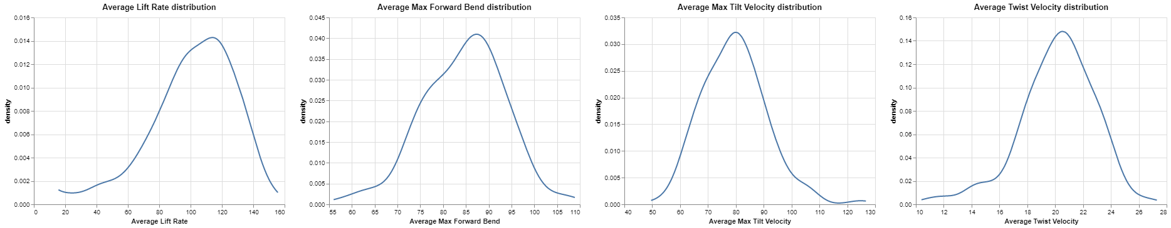
Based on baseline measurements, workers are at the highest risk from unsafe forward bends
Low risk
Medium risk
High risk
Lift rates vary a lot between individuals
Average lift rate is ~ 102 forward bends per hour
Most of the forward bends performed fall into the high-risk category
Side-to-side bend (tilt) speeds fall across the risk spectrum, with most individuals operating below high-risk levels
Torso twist speeds also fall across the spectrum, though the share of high-risk actions is higher than for side-to-side bends

Slide 5
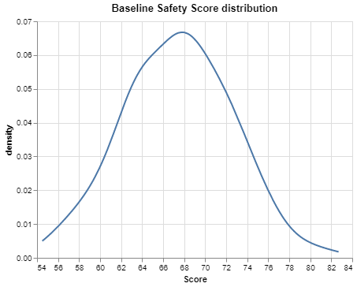
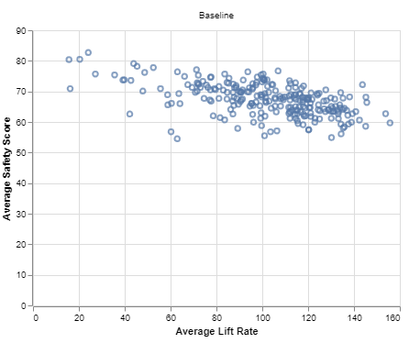
Safety Score metric indicates that more than a half of the workers are at medium risk of injuries, on average
Safety scores and lift rates are inversely related
Workers that lift at higher frequency are higher risk for injuries
On average, increase in lift rate by 10 bends per hour is associated with 1.1 point decline in the safety score (R² of 28%)
Low risk
Medium risk
High risk
Safety Score = 120 –0.2 * forward_bend –0.3 * tilt_speed –0.6 * twist

Slide 6
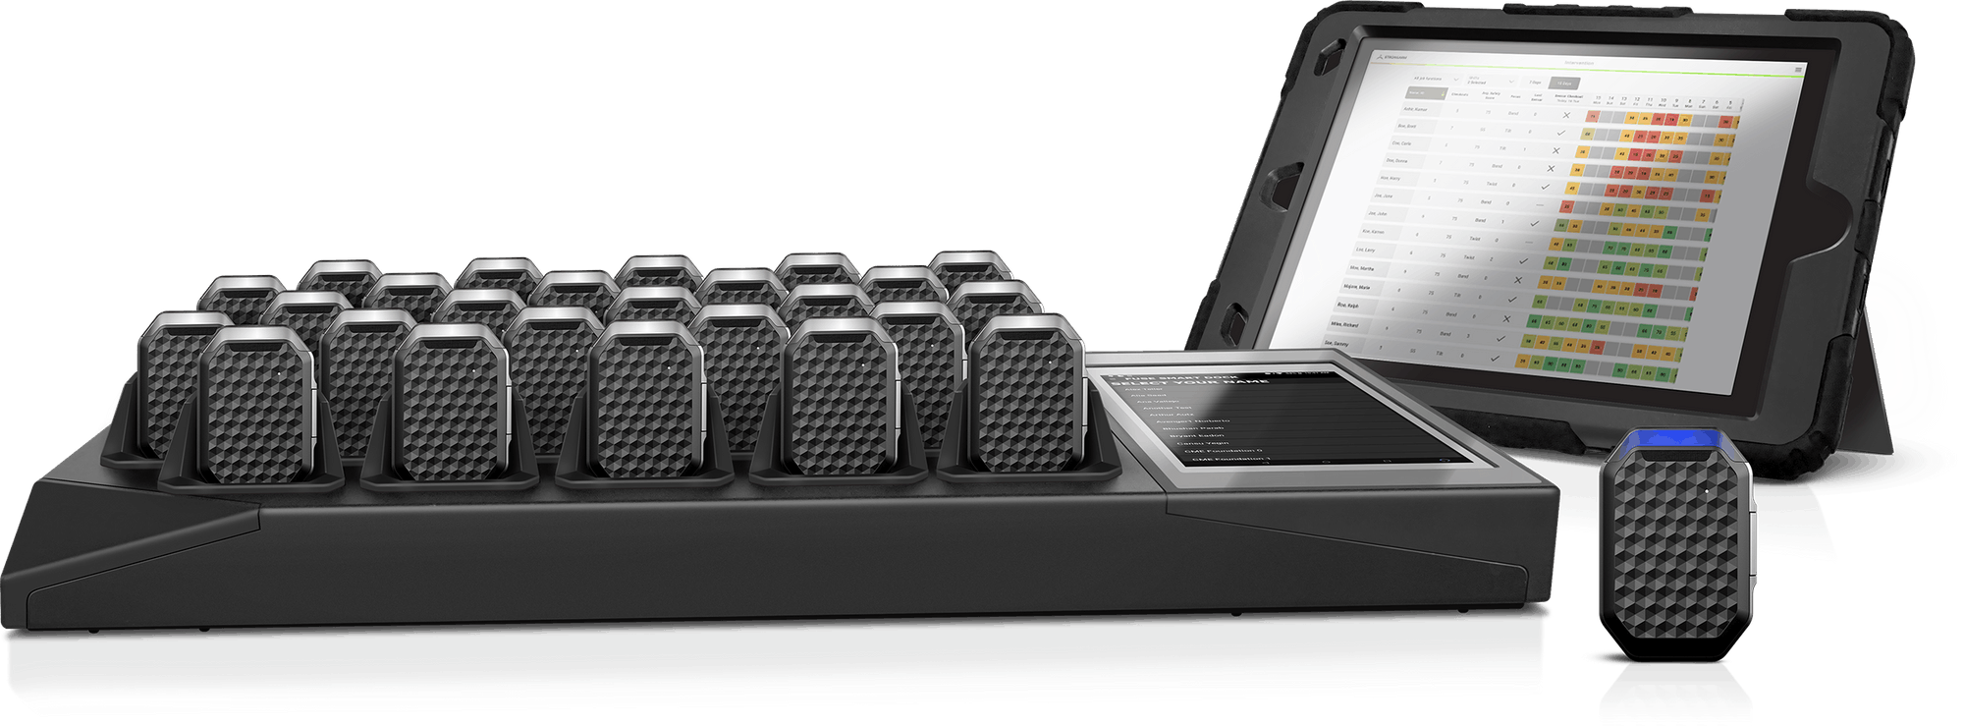
Experiment results

Slide 7
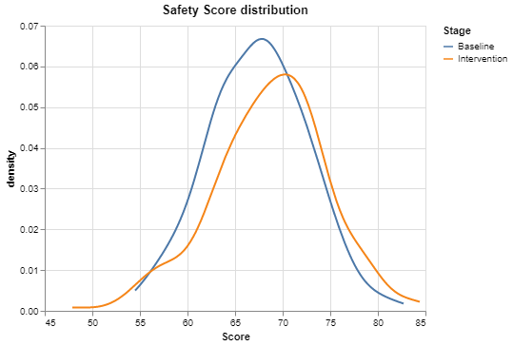
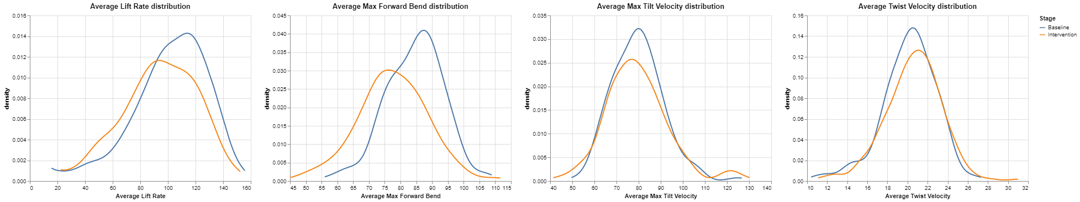
A noticeable shift in unsafe forward bends and safety scores was observed
With interventions in place:
Average safety score is 2.4 points higher (statistically significant difference at 5%)
Maximum average forward bends are 7.6 degrees lower (statistically significant)
Differences in twist and tilt speeds not statistically different

Slide 8
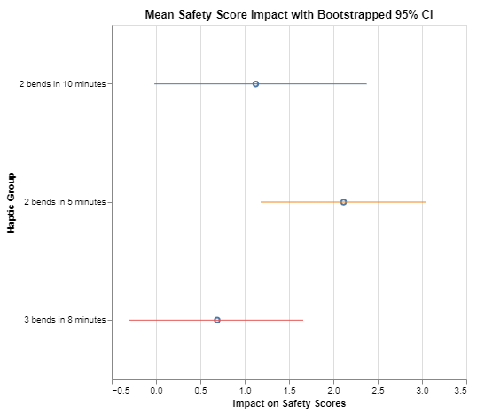
Impact of Haptic feedback configurations and accounting for individual effects
Considerations
Important to capture differences that may be related to individuals themselves
Understand which haptic group (feedback frequency is most effective)
Approach:
Paired t-test by haptic group (testing differences in safety scores on an individual basis)
Results
Feedback after 2 bends in 5 minutes (most frequent feedback) results in highest improvements in the safety scores

Slide 9
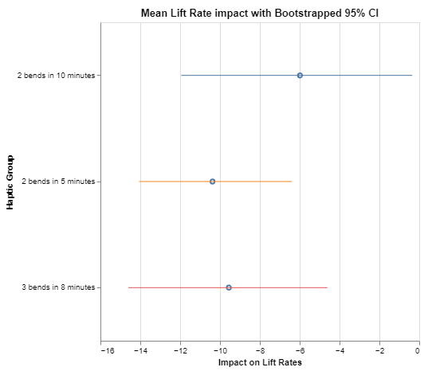
Increase in safety scores came at the expense of lift rates
The 2x5 haptic group resulted in, on average, 10 less lifts per hour
This may be a temporary effect due to workers not used to the haptic feedback
More broadly, analysis indicates that interventions tend to have an “reversal to the mean” impact for both lift rates and safety scores, yet it is the smallest for the “2 bends in 5 minutes” haptic feedback setting

Slide 10
Accounting for changes in lift rates when estimating treatment effects
We already control for individual effects by the nature of experiment design
However, there still may be changes in lift rates between baseline and intervention stages that may drive the safety scores
It would be interesting to know if some haptic group settings are better even after controlling for lift rates
Approach 1:
Regression:
Score ~ lift_rate + haptic group + individual_effect
2x5 the only haptic group with a significant impact
(0.88pt increase in safety scores)
Approach 2:
Bayesian “IV-like” model:
Account for haptic group impact on lift rate change
Use predicted lift changes as a covariate for scores
Include fixed effects at both stages
2x5 the only haptic group with a significant impact
(0.85pt increase in safety scores), best 72% of the time

Slide 11
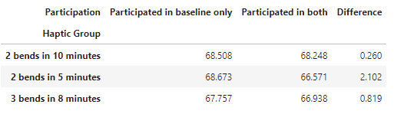
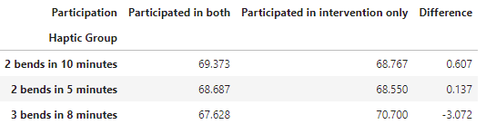
Caveats to the experiment
Baseline Average Safety Scores
Randomization assumptions are critical
A better understanding drop-out / non-participation reasons may influence how the results should be interpreted
Intervention Average Safety Scores

Slide 12
Summary and Next Steps
Observational data indicates that workers over a half of the workers are at medium risk of injuries, with forward bends being the most unsafe, on average
A randomized experiment shows that wearing StrongArm sensors that were calibrated to provide feedback upon unsafe forward bends reduces the risks with statistically significant certainty
The Haptic setting 2x5 performed the best and appears to provide the most value despite having the highest impact on lift rates
Equip workers with sensors calibrated to the 2x5 frequency
Perform follow-up experiments to understand if the impact on lower lift rates is representative
Consider exploring haptic feedback for twist and tilt situations, too

